Slide 1
Dashboard in Tableau
Present By :- C Rangrajan Kumar
Guided By :- Board Infinity

Slide 2
Content
About Dataset
Different types of problem statements
Conclusion

Slide 3
DataSet
I took the data from Kaggle data sets.
https://www.kaggle.com/imdevskp/corona-virus-report?select=country_wise_latest.csv
Dataset contains the information about the Covid-19 information of country wise from all over world.
Some columns of our datasets are Country Name, Confirmed Cases, Recovered Cases, Death Values, Active Cases etc.
Dataset contains also information about WHO Region wise.

Slide 4
Problem Statements
Country Wise confirmed Cases.
Country Wise Recovery Rate.
Country Wise Death Cases.
Country wise Active Cases.
WHO Region wise Confirmed Cases.

Slide 5
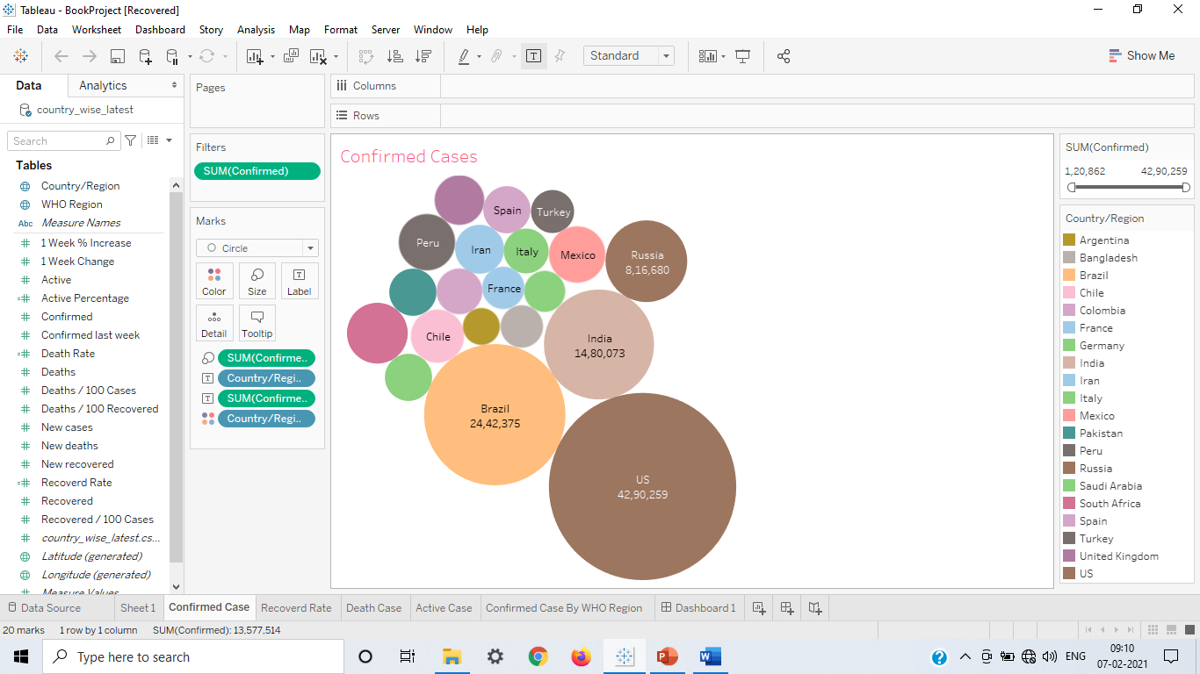
1. Country Wise confirmed Cases.
Covid-19 is a disease, who take under whole world. WHO recall covid-19 disease is pandemic.
In this shows, that the US is the worst country.
In US approx 43 Lac confirmed cases found.
US followed by the Brazil and India.
.

Slide 6
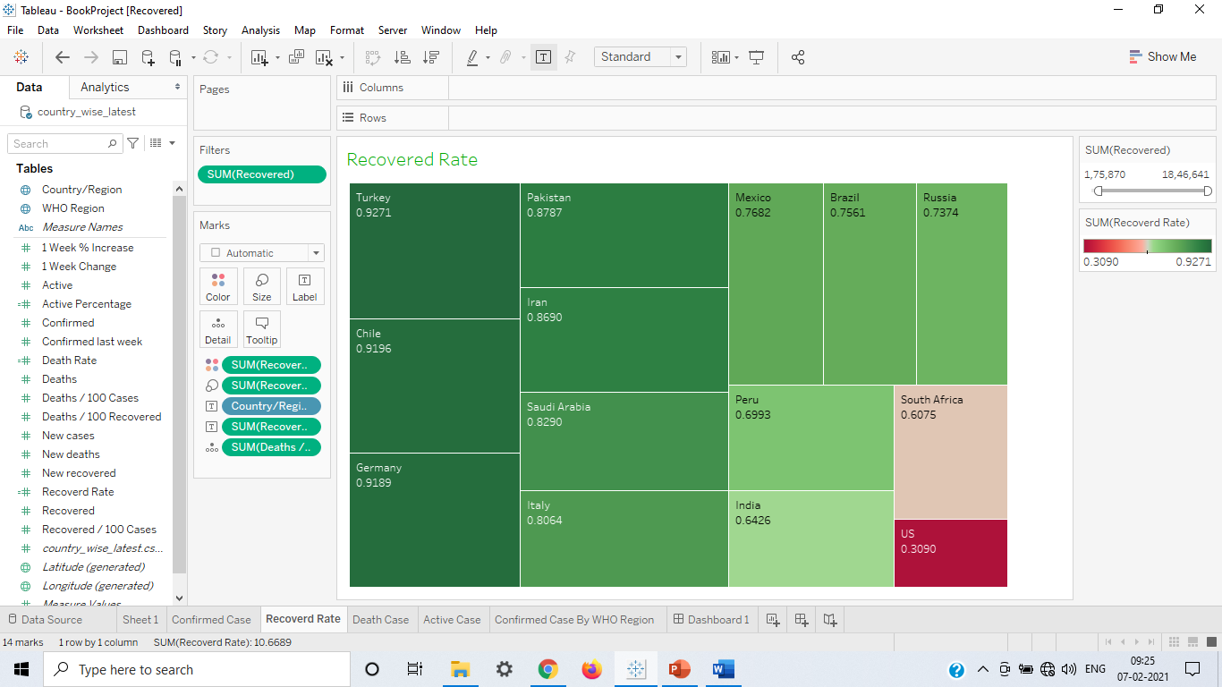
2. Country Wise Recovery Rate.
Patients Recovery was the very important things, when vaccine was not invented.
So that, In this graph show, United state has less recovery rate over entire word.
Turkey has highest recovery rate.
India has 64 percent recovery rate.

Slide 7
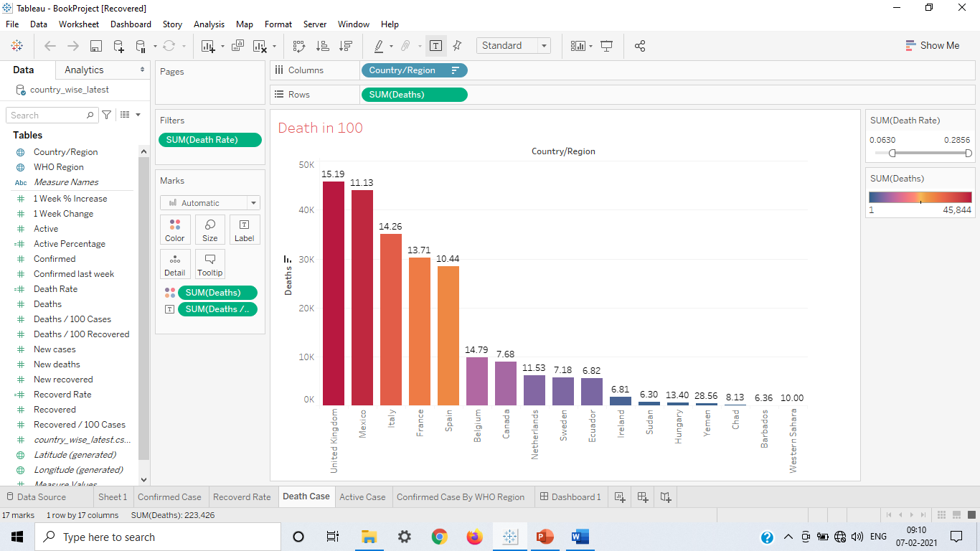
3. Country Wise Death Cases.
If death rate of a country has less, then it is called that country has control on covid-19 pandemic very well.
United Kingdom has highest number of death cases and also death rate is 15 out of 100.
UK followed by Maxico, Italy has most number of death cases.

Slide 8
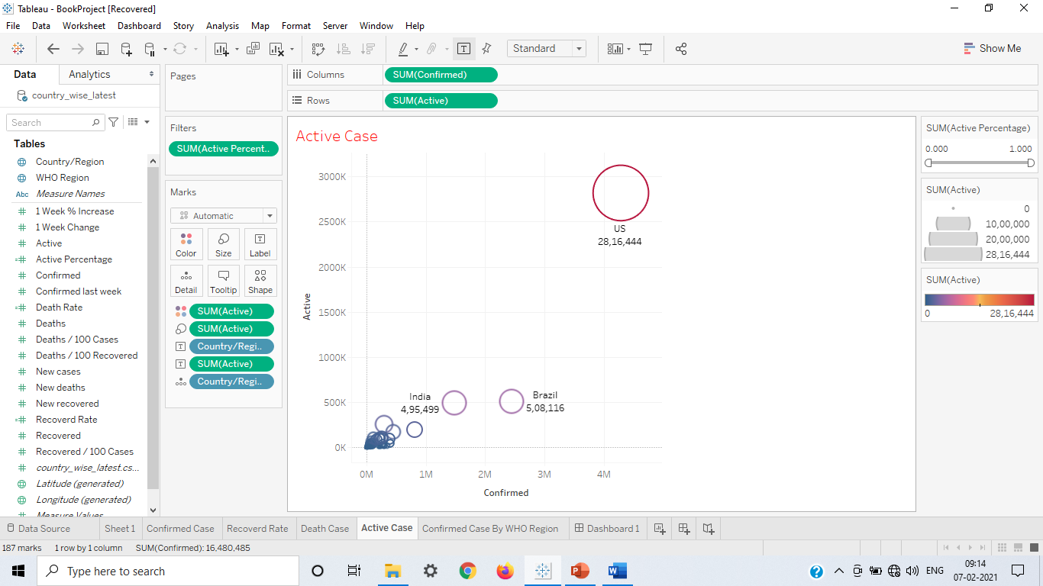
4. Country wise Active Cases.
More active cases present in any country has worry for that country.
In the graph shows that, United States has maximum number of active cases.
US followed by the Brazil, India. Who has more number of cases.
Approx 29 lac active cases present in US followed by 5 lac Brazil.

Slide 9
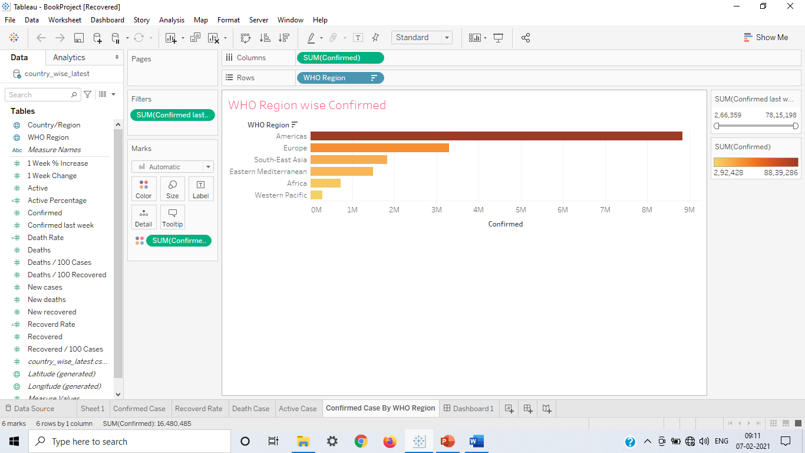
5. WHO Region wise Confirmed Cases.
Every country belong a WHO region.
There are six WHO region.
Americans regions has most number of confirmed cases. It is around 9M.
Europe and South-East Asia hit second and third covid-19 respectively.

Slide 10
Conclusion
I have analyzed the data of Covid-19 country wise dataset with the help of Tableau dashboard and charts present in Tableau sheet and also I can conclude that United States has most badly hit country in the world. US has most number of confirmed, active and death cases. But maximum death rate of United Kingdom and Turkey has maximum recovery rate.

Slide 11
Thank You

